Slide 1
Shopify Sales and Customer Analysis
Name : Challa Harika
Skills : Excel, Power BI Desktop, DAX
Batch : DA/BA

Slide 2
Business Understanding Project Overview: The objective of this project is to analyze Shopify sales data to understand customer purchasing behaviour, sales performance, product performance, payment preferences, and customer retention. The dashboard helps business stakeholders monitor sales KPIs and identify opportunities to improve customer acquisition, retention, and revenue growth.
Business Problem:
The business wants answers to questions such as:
How is revenue changing over time?
Which products generate the highest revenue?
Which customer segments are most valuable?
Which cities contribute the highest sales?
Which payment gateways are preferred?
How frequently do customers purchase?
How long does it take customers to make a second purchase?
Which customers have the highest Customer Lifetime Value (CLV)?
How well are customers retained over time?

Slide 3
Data Collection
Data Source: Shopify Sales Dataset
Dataset contains:
Order Number
Customer ID
Order Date
Product Type
Product Name
City
ZIP Code
Payment Gateway
Quantity
Sales Amount
Customer Segment
Order Status
Data Size: 7420 Rows, 9 Columns
Total Revenue: 4.28k
Total Orders: 6
Total Customers: 6

Slide 4
Data Cleaning & Transformation
The dataset was cleaned using Power Query.
Data Cleaning Steps
Removed duplicate records
Corrected data types
Removed null values
Renamed columns
Merged columns
Created Date table
Created Customer Cohorts
Generated First Purchase Date
Generated Second Purchase Date
Created Customer Segments
Created RFM Segments
Created Spend Tier
Established relationships between tables

Slide 5
Data Modeling
Star Schema
Fact Table
Shopify Sales Dimension Tables
Date Table
Relationships
Date Table (Date)
↓
Shopify Sales (Order Date)
Additional Calculated Columns
First Purchase Date
Second Purchase Date
Customer Type
Purchase Frequency
Days to Return
Return Bucket
Customer Cohort

Slide 6
DAX Documentation with Explanations
Total Revenue = SUM(shopify_sales[Revenue])
Note: Total Price Usd renamed this column to Revenue
Calculates the overall revenue generated from all sales transactions.
2. Total Orders = DISTINCTCOUNT(shopify_sales[Order Number])
Counts the total number of unique customer orders.
3. Total Customers = DISTINCTCOUNT(shopify_sales[Customer ID])
Calculates the number of unique customers.
4. Average Order Value = DIVIDE([Total Revenue],[Total Orders])
Measures the average revenue generated per order.
5. Revenue per Customer = DIVIDE([Total Revenue],[Total Customers])
Calculates the average revenue generated by each customer.
6. Purchase Frequency = DIVIDE([Total Orders],[Total Customers])
Measures how frequently customers place orders on average.
7. Estimated CLV = [Average Order Value] * [Purchase Frequency]
Estimates the average lifetime value of a customer using order value and purchase frequency.
8. First Purchase Date = CALCULATE( MIN(shopify_sales[Order Date]),
ALLEXCEPT(shopify_sales,shopify_sales[Customer ID]))
Finds the first purchase made by each customer.

Slide 7
9. Second Purchase Date =
VAR CurrentCustomer = shopify_sales[Customer ID]
VAR CustomerOrders =
SUMMARIZE(
FILTER(
ALL(shopify_sales),
shopify_sales[Customer ID] = CurrentCustomer
),
shopify_sales[Order Number],
shopify_sales[Order Date]
)
VAR SecondOrder =
TOPN(
2,
CustomerOrders,
shopify_sales[Order Date], ASC,
shopify_sales[Order Number], ASC
)
RETURN
IF(
COUNTROWS(CustomerOrders) >= 2,
MAXX(SecondOrder, shopify_sales[Order Date]),
BLANK()
)
10. Days to Return =
DATEDIFF(
shopify_sales[First Purchase Date],
shopify_sales[Second Purchase Date], DAY)
Calculates the number of days taken for a customer to make their second purchase.
11. Customer Type =
IF(
shopify_sales[Order Date]=shopify_sales[First Purchase Date],
"New",
"Returning"
)
Classifies customers as New or Returning.
12. Average Days to Second Purchase =
AVERAGEX(
FILTER(
VALUES(shopify_sales[Customer ID]),
CALCULATE(
DISTINCTCOUNT(shopify_sales[Order Number])
) >= 2
),
CALCULATE(
MIN(shopify_sales[Days to Second Purchase])
)
)

Slide 8
13. Customer Cohort =
FORMAT(
shopify_sales[First Purchase Date],
"YYYY-MM"
)
Groups customers based on the month of their first purchase.
14. Cohort Retention Rate =
DIVIDE(
[Returning Customers],
[New Customers]
)
Measures customer retention over time.
15. Return Bucket =
SWITCH(
TRUE(),
ISBLANK(shopify_sales[Days to Return]),"No Repeat Purchase",
shopify_sales[Days to Return]<=30,"Within 30 Days",
shopify_sales[Days to Return]<=60,"31-60 Days",
shopify_sales[Days to Return]<=90,"61-90 Days",
"90+ Days"
)
Groups customers based on the time taken to make a repeat purchase.
16. Repeat Rate =
DIVIDE(
CALCULATE(
DISTINCTCOUNT(shopify_sales[Customer ID]),
NOT ISBLANK(shopify_sales[Second Purchase Date])
),
DISTINCTCOUNT(shopify_sales[Customer ID]),
0
)
17. Second Purchase Rate =
VAR TotalCustomers =
DISTINCTCOUNT(shopify_sales[Customer ID])
VAR RepeatCustomers =
COUNTROWS(
FILTER(
VALUES(shopify_sales[Customer ID]),
CALCULATE(
DISTINCTCOUNT(shopify_sales[Order Number])
) > 1
)
)
RETURN
COALESCE(
DIVIDE(RepeatCustomers, TotalCustomers, 0),
0
)

Slide 9
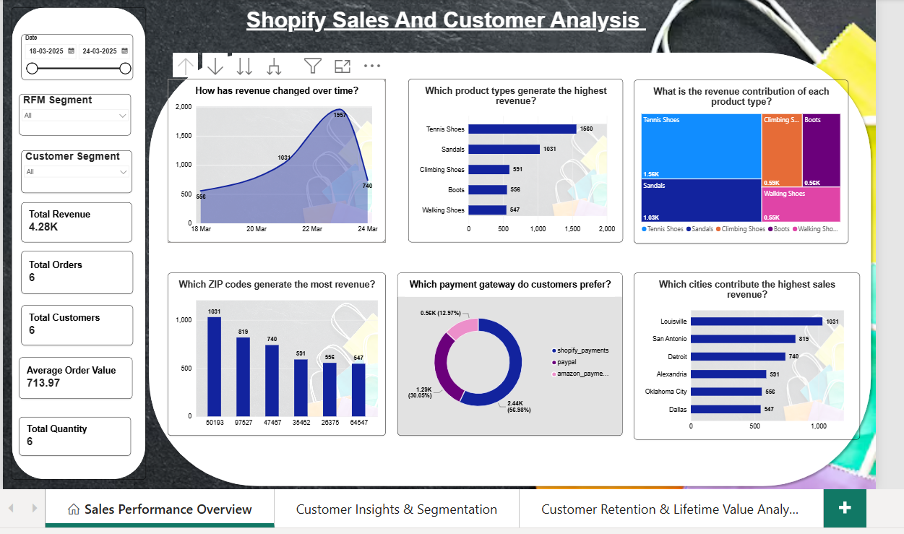

Slide 10
Sales Performance Overview
How is the business performing overall?
A. Total revenue generated is 4.28K from 6 orders and 6 customers.
5. Which ZIP codes generate the highest revenue?
ZIP Code 50193 generated the highest sales among all postal regions.
6. Which payment gateway do customers prefer?
Customers predominantly prefer Shopify Payments, followed by PayPal, with Amazon Pay being the least used gateway.
7. Which cities contribute the highest sales?
A. Louisville contributes the highest city-level revenue, making it a strategically important market.
2. How has revenue changed over time?
Revenue peaked on 23 March before declining on the final day in the selected period.
3. Which product types generate the highest revenue?
Tennis Shoes are the highest-performing product category, followed by Sandals.
4. What is the revenue contribution of each product type?
A. Revenue is concentrated in a few product categories, indicating potential dependence on key products.

Slide 11
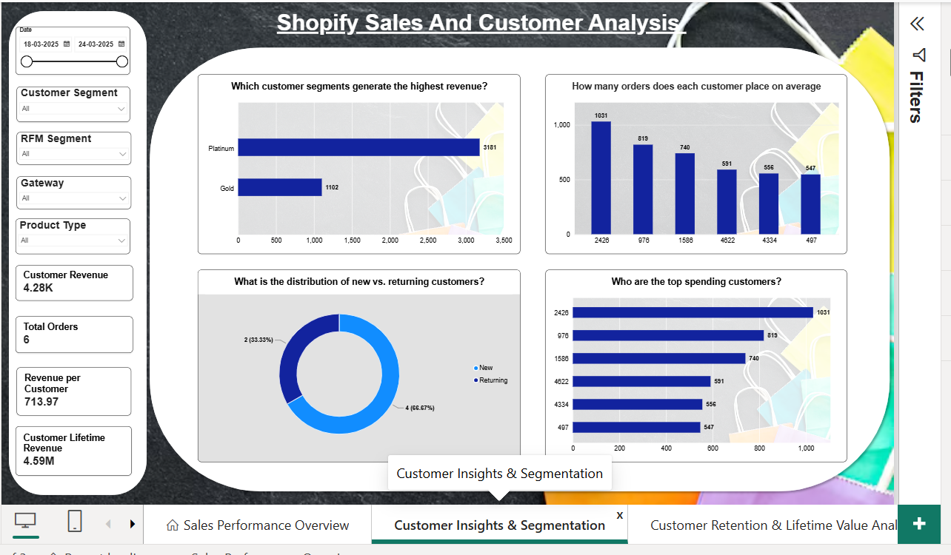

Slide 12
Customer Insights & Segmentation
1. KPIs:
Customer Revenue : 4.28k
Total Orders : 6
Revenue per Customer : 713.97
Customer Lifetime Revenue : 4.59M
2. Which customer segment generates the highest revenue?
Platinum customers contribute nearly three times the revenue of Gold customers, demonstrating the importance of high-value customer segments.
3. How many orders does each customer place on an Average?
A. Average revenue per customer is approximately 713.97, showing a relatively high spend per customer in the available dataset.
4. What is the distribution of new vs. returning customers?
The customer base is largely composed of new customers (66.7%), while returning customers account for 33.3%, indicating opportunities to strengthen customer loyalty.
5. Who are the top spending customers?
A. A small number of customers generate the majority of revenue, suggesting a concentrated customer value distribution.

Slide 13
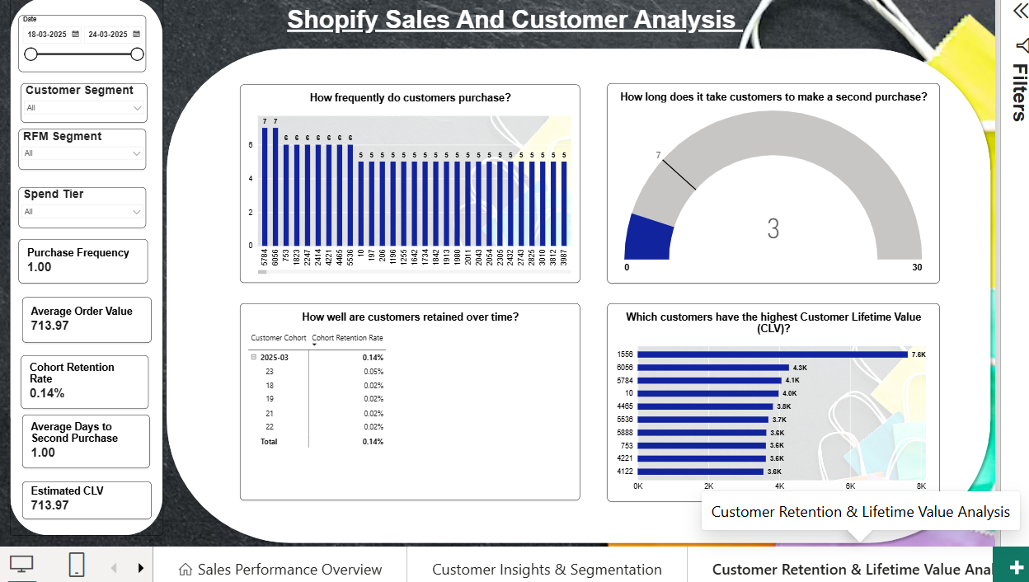

Slide 14
Customer Retention & Lifetime Value Analysis
KPI’s:
Purchase Frequency : 1.00
Average Order Value :713.97
Cohort Retention Rate : 0.14%
Average Days to Second Purchase : 1.00
Estimated CLV: 713.97
2. How frequently do customers purchase?
A. The average purchase frequency is 1 order per customer, indicating that most customers have made only a single purchase during the analysis period.
3. How long does it take customers to make a second purchase?
Customers who return tend to make their second purchase very quickly (approximately 1 day on average), but the number of repeat customers is limited.
4. Which customers have the highest Customer Lifetime Value (CLV)?
A. Customer Lifetime Value (CLV) analysis identifies a small group of high-value customers who contribute a disproportionate share of total revenue.
5. How well are customers retained?
A. The cohort retention rate of 0.14% highlights weak long-term customer retention.

Slide 15
Business Investigation and Recommendation
Business Investigation by City: Revenue by City Identified highest-revenue city and lowest-revenue city
Highest-Revenue-City Insight:
Finding: Total revenue is 132.30K from 212 customers and 217 orders; Washington is the highest-revenue city, while New Customers generate more revenue than Returning Customers.
Comparison: New-customer revenue is higher than returning-customer revenue, and overall purchase frequency is 1.02 orders per customer, indicating limited repeat purchasing in the observed dataset.
Driver: The low purchase frequency suggests that repeat orders are limited, so customer acquisition currently contributes more revenue than repeat purchasing.
Insight: The business appears to rely more on acquiring new customers than generating repeat orders, creating an opportunity to improve second-purchase conversion and customer value.
Recommendation: Focus post-purchase retention campaigns on first-time customers and prioritize high-value customer segments/products for repeat-purchase offers.
KPI to monitor: Second Purchase Rate, Purchase Frequency, Average Days to Second Purchase, Returning Customer Revenue, and Revenue per Customer.
Lowest-Revenue-City Insight:
Finding: Staten Island generated 546.84 revenue from 1 customer and 1 order, with an AOV of 546.84 and purchase frequency of 1.00.
Comparison: Compared with higher-revenue cities such as Washington, Staten Island has substantially lower revenue and customer/order volume.
Driver: The primary observable driver is the very small customer and order base (1 customer, 1 order); the Second Purchase Rate is 0%, confirming no repeat purchase was observed.
Insight: Staten Island's low revenue appears to be driven mainly by low customer and transaction volume, rather than evidence of low spending among a larger customer base. With only one customer, the result is directional and should not be generalized.
Recommendation: Investigate whether Staten Island has limited customer acquisition/market reach and test targeted acquisition or awareness initiatives before prioritizing retention strategies.
KPI to monitor: Customers, Orders, Revenue, AOV, Purchase Frequency, Second Purchase Rate, and New Customer Acquisition Rate.

Slide 16
2. Business Investigation by Customer Type: Revenue by Customer Type Identified New vs Returning
New Customers Insight: Finding: New customers generated 2.74M revenue from 4.43K customers and 4K orders, with purchase frequency of 1.00 and AOV of 618.01.
Comparison: New customers contribute a larger share of observed revenue than returning customers (2.74M vs 1.86M), primarily because there are more new customers.
Driver: Revenue from new customers is primarily driven by customer volume, while purchase frequency is only 1 order per customer.
Insight: The business currently depends substantially on new-customer acquisition for revenue, while new customers show limited repeat-order behavior in the observed data.
Recommendation: Continue acquiring new customers, but introduce a structured first-to-second-purchase journey to convert more newly acquired customers into repeat buyers.
KPI to monitor: New Customer Revenue, New Customers, Second Purchase Rate, Purchase Frequency, and Revenue per New Customer.
Returning Customers Insight: Finding: Returning customers generated 1.86M revenue from 2.99K customers and approximately 3K orders, with purchase frequency of 1.47 and AOV of 620.09.
Comparison: Returning customers have a higher purchase frequency (1.47 vs 1.00) than new customers, while AOV is almost the same (620.09 vs 618.01).
Driver: The stronger revenue contribution from returning customers is driven mainly by higher purchase frequency, not by substantially higher order value.
Insight: Repeat purchasing appears to be the key differentiator in customer value: returning customers place more orders per customer while spending approximately the same amount per order.
Recommendation: Prioritize retention and loyalty strategies that encourage returning customers to purchase more frequently, such as personalized cross-sell, replenishment reminders, and loyalty benefits.

Slide 17
3. Business Investigation by Product Type: Revenue by Product Type
Identified Highest and Lowest Product Type
Highest Product type Insight: Finding: Running Shoes generated 1.62M revenue from approximately 2K customers and 3K orders, with purchase frequency of 1.23 and AOV of 617.63.
Comparison: Running Shoes have substantially higher revenue and transaction volume than the lowest-performing product, Water Shoes (2.80K revenue, 5 customers, 5 orders).
Driver: The strong revenue is mainly associated with high customer/order volume, while purchase frequency of 1.23 indicates some repeat purchasing; the product also has a 20% Second Purchase Rate.
Insight: Running Shoes are a major revenue-generating product with both strong acquisition volume and some repeat-purchase activity, making them an important product to protect and grow.
Recommendation: Prioritize inventory availability, targeted cross-selling, and retention campaigns for Running Shoes customers to increase repeat purchases and customer value.
KPI to monitor: Product Revenue, Orders, Customers, AOV, Purchase Frequency, Second Purchase Rate, and Returning Customer Revenue.
Lowest Product Type Insight: Finding: Water Shoes generated only 2.80K revenue from 5 customers and 5 orders, with purchase frequency of 1.00 and AOV of 559.60.
Comparison: Water Shoes have extremely low customer and order volume compared with Running Shoes, which generated 1.62M revenue.
Driver: The immediate observable driver is very low customer and order volume, while the Second Purchase Rate is 0%, indicating no observed second purchase under the current measure.
Insight: Water Shoes have limited observed demand and no observed repeat purchasing, but the dataset alone does not establish whether the issue is product demand, customer acquisition, seasonality, or product positioning.
Recommendation: Investigate demand first by comparing Water Shoes with similar products, customer locations, and sales periods before increasing promotions or inventory; consider a targeted test rather than assuming discounts will solve the problem.
KPI to monitor: Product Revenue, Customers, Orders, AOV, Purchase Frequency, Second Purchase Rate, and Product Revenue Share.

Slide 18
Final Business Insights: Overall, three key insights emerged from the analysis.
First, revenue is strongly influenced by customer and order volume.
Second, new customers are an important revenue source, while returning customers generate additional value through higher purchase frequency.
Third, high-performing products and customer segments represent important opportunities, while low-performing cities and products require further investigation before taking corrective action.
Recommendations: Based on these findings, I recommend three actions.
First, improve second-purchase conversion through targeted post-purchase engagement for first-time customers.
Second, strengthen retention and loyalty strategies for high-value and returning customers.
Third, investigate low-performing cities and products by separating customer volume, order volume, AOV and repeat behaviour before introducing discounts or other interventions.

